Slide 1















CAPSTONE PROJECT
PLAY STORE APP REVIEW ANALYSIS
PRESENT BY:
Jijabai dhanwate

Slide 2




WHY ANALYZE THE GOOGLE PLAY STORE?
Mobile App Market is set to grow 20% by 2023
Android Apps comprise 90% of the Mobile App Market
What makes an App popular? Can we predict how popular it’s going to be?
What are some interesting patterns in user behavior related to app usage & feedback?

Slide 3


INTRODUCTION
Android is the most popular operating system in the world, with over 2.5 billion active users spanning over 190 countries.
Google Play was launched on March 6, 2012, bringing together Android Market marking a shift in
Google's digital distribution strategy .
Android is the dominant mobile operating system today more than 85% of all mobile devices running Google’s OS. The Google Play Store is the largest and most popular Android app store.
There are more than 3.04 million apps found on Google Play Store.
The Play Store apps data has enormous potential to drive app-making businesses to success.
Actionable insights can be drawn for developers to work on and capture the Android market. The main goal of our project is-
The purpose of our project is to gather and analyze detailed information on apps in the Google Play Store in order to provide insights on app features and the current state of the Android app market.
The Objective of the project to Explore and analyze the data to discover key factors responsible for app engagement and success.

Slide 4


* Two datasets are provided, one with basic information and the other with user reviews for the respective app.
* We must examine and evaluate the data in both datasets in order to identify the
important characteristics that inﬂuence app engagement andsuccess.
So, what factors inﬂuence an app'ssuccess?
An app is said to be successful if it has:
* A high average user rating
* A good number of positive reviews
* A good number of monthly average users
* High revenue per customer and so on.

Slide 5

AGENDA
Introduction
Category wise play store apps installs
Category wise most popular apps
Top 10 apps in play store considering all the parameters
Average installs, category wise
Most installed apps in communication category
Average sizes of apps in each category
Category wise percentage of paid apps
Category wise top installed paid apps
Average rating of paid apps
Correlation between Rating ,Installs and Price
Category wise installed apps with content rating
Percentage reviews sentiment distribution

Slide 6
DATASET PREPARATION
Loading the data sets: Two datasets, First Play store app dataset and User Reviews dataset.
Import Libraries: NumPy, Pandas, Seaborn and Matplotlib
Data cleaning: Null values, Finding and removing Removing duplicate data.
Outliers,
Data Imputation: Filling the missing categorical values with mode and numerical values with median. Conversion of price, installs, reviews into numerical values.
Exploratory Data Analysis: Analyzing the data sets to summarize their main characteristics using statistical graphics and data visualizations method.

Slide 7
ATTRIBUTES IN PLAY STORE DATA
APP :THIS COLUMN CONTAINS THE NAME OF THE APP FOR EACH OBSERVATION.
CATEGORY :THIS COLUMN CONTAINS CATEGORY TO WHICH THE APP BELONGS.
RATING :THIS COLUMN CONTAINS THE AVERAGE RATING FOR THE APP.
REVIEWS :THIS COLUMN CONTAINS THE NUMBER OF REVIEWS THAT THE APP HAS RECEIVED ON THE PLAY STORE.
SIZE :THIS COLUMN CONTAINS THE AMOUNT OF MEMORY THE APP OCCUPIES ON THE DEVICE.
INSTALLS :THIS COLUMN CONTAINS THE NUMBER OF TIMES THAT THE APP HAS BEEN
DOWNLOADED AND INSTALLED FROM THE PLAY STORE.
TYPE :THIS COLUMN CONTAINS THE INFORMATION WHETHER THE APP IS FREE OR PAID.
PRICE: IFTHE APP IS APAID APP, THIS COLUMN CONTAINS THE DATA ABOUT ITS PRICE.
CONTENT RATING: THIS COLUMN CONTAINS THE MATURITY RATING OF THE APP I.E.THE AGE GROUP OF THE AUDIENCE FOR WHICH IT IS SUITABLE.
GENRES: THIS COLUMN CONTAINS THE DATA ABOUT TO WHICH GENRE THE APP BELONGS.
GENRES CAN
BE CONSIDERED AS A FURTHER DIVISION OF THE GROUP OF CATEGORY.
LAST UPDATED: CONTAINS THE DATE ON WHICH THE LATEST UPDATE OF THE APP WAS RELEASED.
CURRENT VERSION: CONTAINS INFORMATION ON THE CURRENT VERSION OF THE APP
AVAILABLE ON THE PLAY STORE.
ANDROID VERSION: CONTAINS INFORMATION ABOUT THE ANDROID VERSIONS ON WHICH THE APP IS SUPPORTED.

Slide 8
ATTRIBUTES IN USER REVIEWS
App- Application name
Translated Review- User review
Sentiment- Positive/Negative/Neutral
Sentiment Polarity- Sentiment polarity score
Sentiment Subjectivity- Sentiment subjectivity score

Slide 9





Data Cleaning
Data Exploration
Predictive Modeling
Understand the structure of the dataset and clean data before analysis
Uncover initial patterns, characteristics, and points of interest using visual exploration
Formulate a statistical model to forecast an outcome using relevant predictors

Slide 10
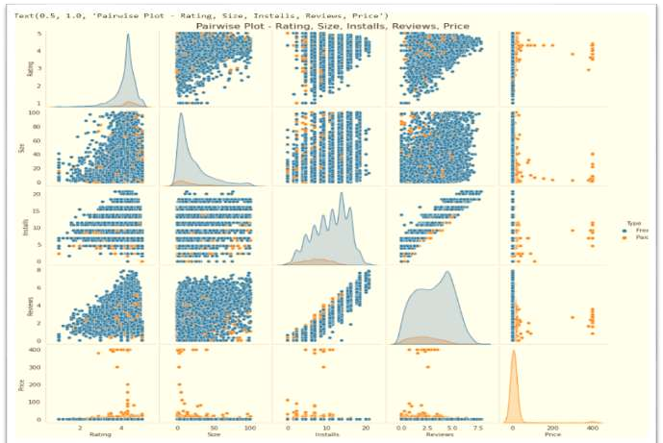
PAIRWISE PLOT- RATINGS, SIZE, INSTALLS, REVIEWS, PRICE

Slide 11


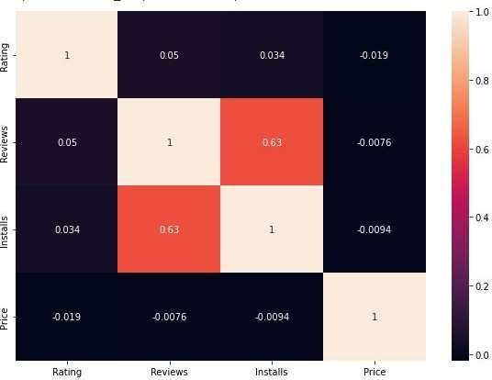
❏ There is a strong positive correlation between the Reviews and Installs.
❏ The Price is
negatively correlated
slightly with
the Rating, Reviews,and Installs.
❏ The
Rating is slightly positively
correlated
Reviews.
with
the Installs and

Slide 12
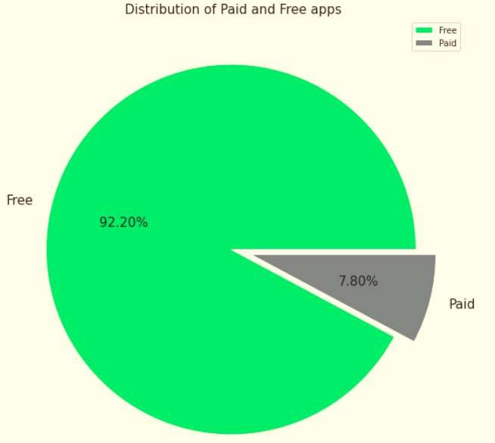
Percentage of Paid apps v/s Free apps
We Observed that 92.20% of Apps are free and only 7.80% of Apps are paid in Play store.

Slide 13


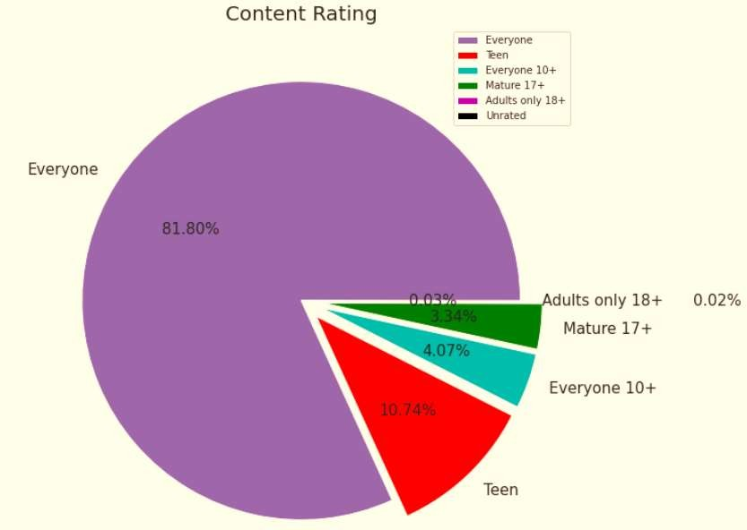
From the above plot we can see that Everyone category having majority of apps count.
A majority of the apps (81.80%) in the play store are can be used by everyone. The remaining apps have various age restrictions to use it.

Slide 14
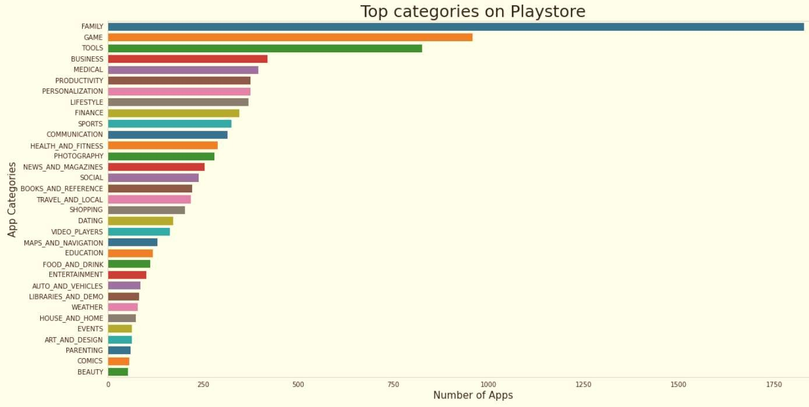
Family and Game apps have the highest market prevalence. Surprising Tools, Business and Medical apps are also at the Top Count of applications.

Slide 15







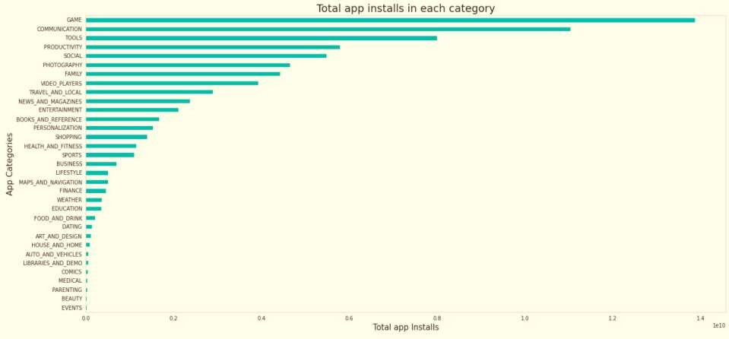
The Game, Communication and Tools categories has the highest number of insta lls compared to other categories of apps.

Slide 16






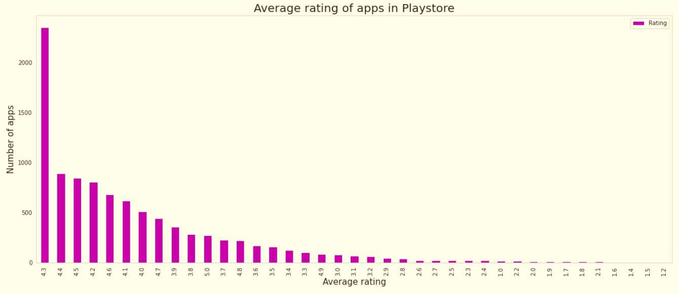

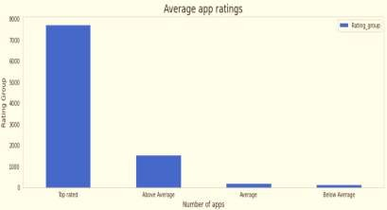
❏ The average user rating is divided into 4 categories:
Rating: 4-5⇒Top Rated
Rating: 3-4⇒AboveAverage
Rating: 2-3⇒Average
Rating: 1-2⇒Below Average
❏ The majority of the apps in the Play Store (~80%) are top rated.
❏ This implies that the majority of the users are happy with the services received via the respective app.

Slide 17







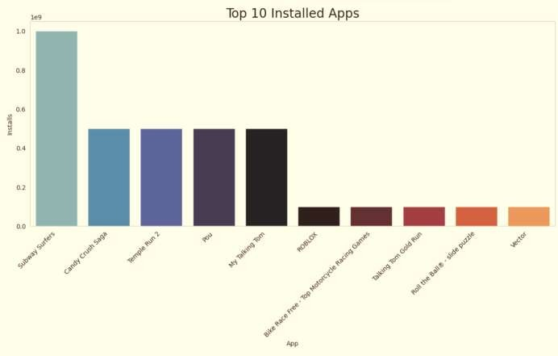
This graph shows the top installed apps in the ‘Games’ category. Further looking into the play store reveals that these apps are light, casual, single player games.

Slide 18



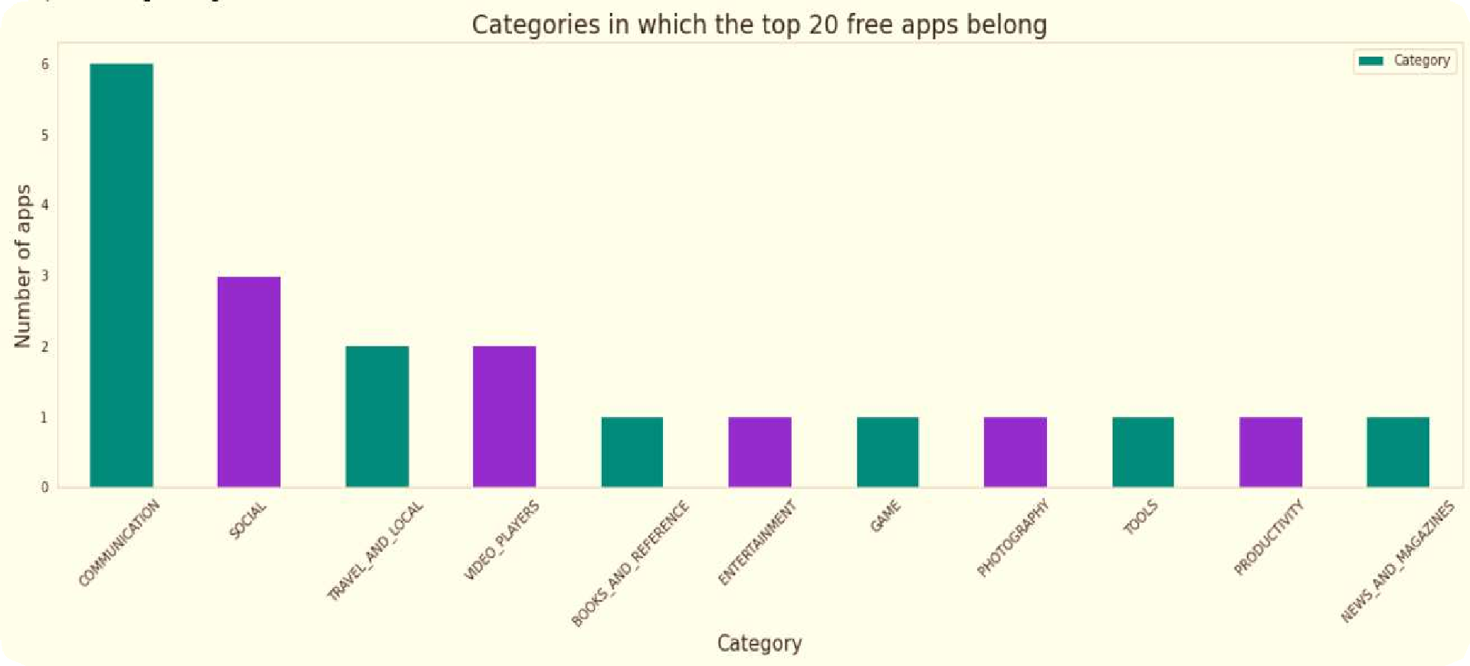
❏ There are a total of 20 free apps with over
one billion installs.
❏ The top categories in which these apps fall are Communication(6), Social(3), Video Players(2), Travel and Local(2).

Slide 19







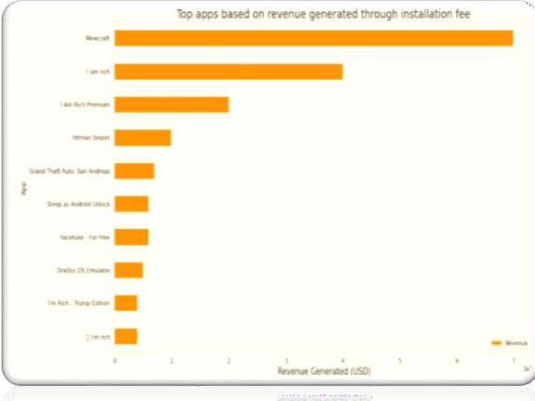
Revenue generated is given by the
formula:
Revenue = Installs* Price
Note that in this case, revenue
refers to the money earned only
from paid appinstalls.
The top categories in which these apps fall are Lifestyle(5), Family(5), and Game(4).
Minecraft, I am rich, and I am rich premium are the top paid apps based on revenue generated.
Minecraft is the only app that has
over 10 M installs.

Slide 20

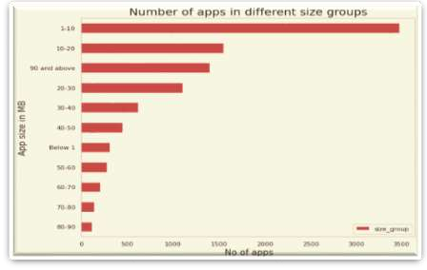
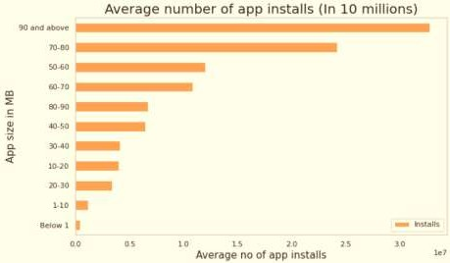

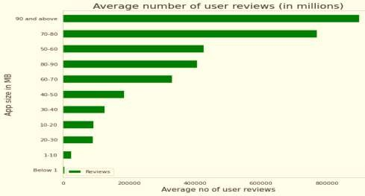
❏ The apps are categorized based on its size between
~0 to 100 MB in the intervals of 10 MB each.
❏
❏
The total number of apps in each size category indicates the competition.
Average number of user reviews and average app installs in each size category indicates the popularity of the respective app.

Slide 21






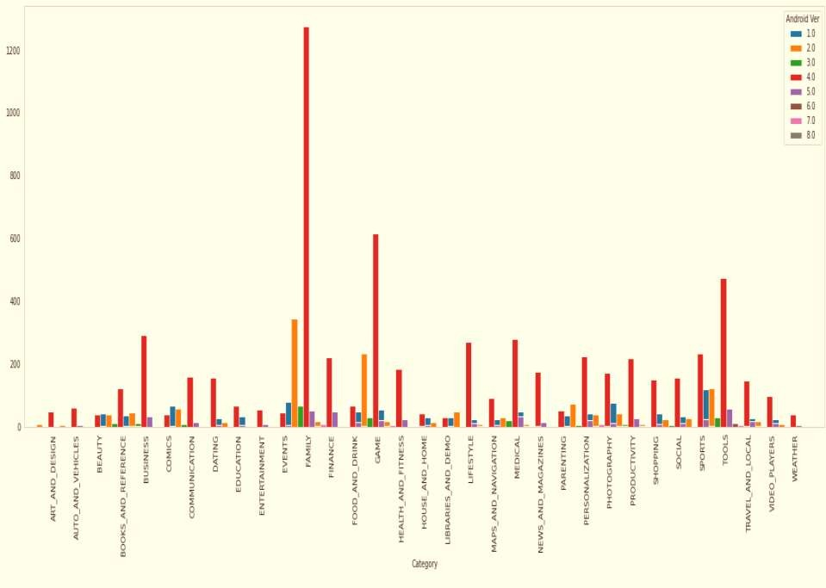

Slide 22




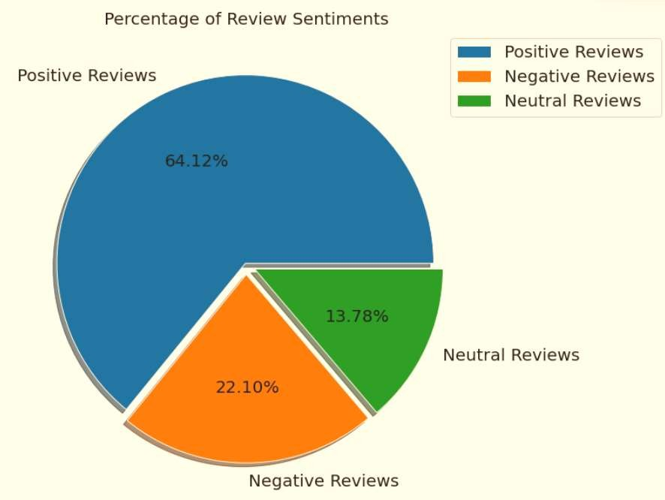
The number of Unique Apps from Play store and User reviews merged dataset are 816.
From Sentiment column, 64% are Positive, 22% are Negative and 14% are Neutral values.

Slide 23




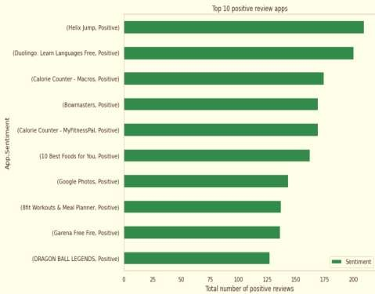
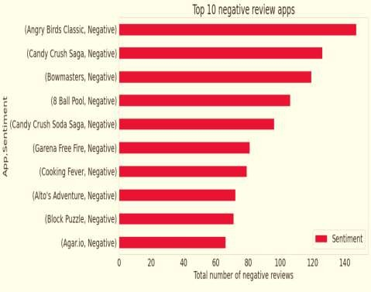
Helix Jump is a App from merged dataset has highest 209 Positive sentiment count.
Angry Bird Classic is a app from merged dataset has highest 147 Negative sentiment count.

Slide 24






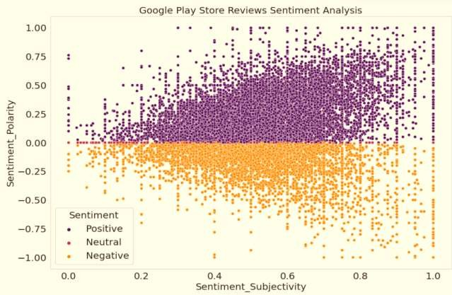
From the above scatter plot it can be concluded that sentiment subjectivity is not
always sentiment maximum shows a behavior, when
proportional to
polarity but in
number of case,
proportional
variance is
too high or low

Slide 25





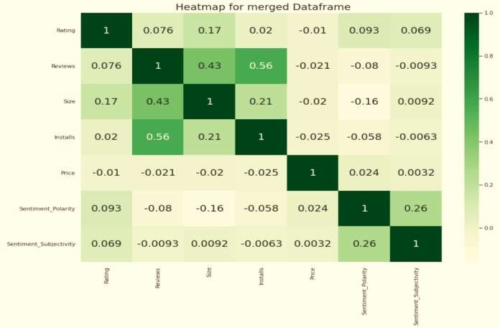
In this correlation matrix, There is not a
significant between Reviews,
relationship
Rating,
Size and
Installs with respect to the Sentiment polarity and Sentiment subjectivity.

Slide 26






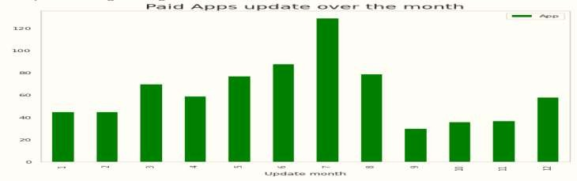
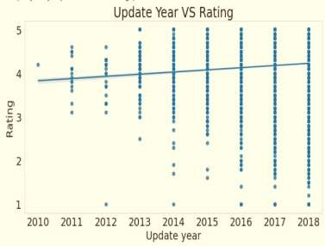
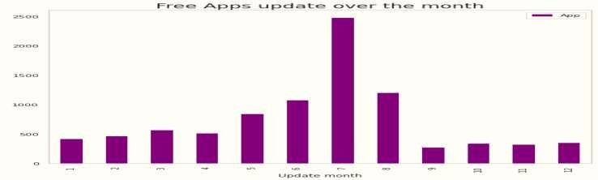

Slide 27


❏ Reading the dataset and comprehending the problem statement.
❏ Examining the business KPIs for app development and devising a solution
to the problem.
❏ Handling the error, duplicate and NaN values in the dataset.
❏ Designing multiple visualizations to summarize the information in the
dataset and successfully communicate the results and trends to the reader.

Slide 28

92.19% apps are Free and 7.81% apps are paid in type.
81.80% apps have Everyone content rating.
Events category has a highest mean rating of 4.39 and Dating category has lowest 4.05 rating. Family, Game and Tools are top three categories having 1906, 926 and 829 app count.
Most competitive category: Family
Category with the highest number of installs: Game
Tools, Entertainment, Education, Business and Medical are top Genres.
8783 Apps are having size less than or equal to 50 MB.
7749 Apps has rating more than 4.0 including both type of app.
Overall sentiment count of merged dataset in which Positive sentiment count is 64%, Negative
22% and Neutral 14%.

Slide 29

It's good to develop a Free type app and having a content rating for Everyone.
Percentage of apps that are top rated = 81.80%
There are 20 free apps that have been installed over a billion times
Minecraft is the only app in the paid category with over 10M installs, and also has produced the most revenue only from installation fee.
Price, Rating, Size has no or very less correlation with Sentiment Polarity.
The median size of the apps in the play store is 12 MB
The apps whose size varies with device has the highest number average app installs.
The apps whose size is greater than 90 MB has the highest number of average user reviews, i.e., they are more popular than the rest.
Helix Jump has the highest number of positive reviews and Angry Birds Classic has the
highest number of negative reviews.

Slide 30

THANK YOU

